Slide 1
ADAPTIVE IMMUNE RESPONSE
Activation of B and T cells
Prof. Nizar Abuharfeil
Jordan University of Science and Technology

Slide 2
Lecture outline
Activation of B cells
A. Dendritic cell maturation in response to a pathogen
B. Activation of CD4+ cells
C. Activation of B cells
D. Cooperation between selected activated CD4+ and B cells
E. Clonal expansion and differentiation of activated B cells to plasma cells
F. Events in germinal centers
G. T-independent B cell response
H. Other ways to activate T cells
F. Modulation of B cell activity
Activation of T cells
A. Activation and Function of CD8+ T cells
B. CD4-Independent activation of CD8+ T cells
C. CD4-dependent activation of CD8+ T cells
D. Killing of target cells by CD8+ T cells
E. Termination of the CD8+ T cell response
F. The traffic of activated CD8+ T cell
G. γδ cells and NKT cells

Slide 3
T-dependent and T-independent Immune Response
Thymus-dep. (TD) Ags: Most Ags are known as because the responding B cells require the help of Th cells.
The thymus-indep Ags (TI): the responding B cells do not require Th cells.

Slide 4
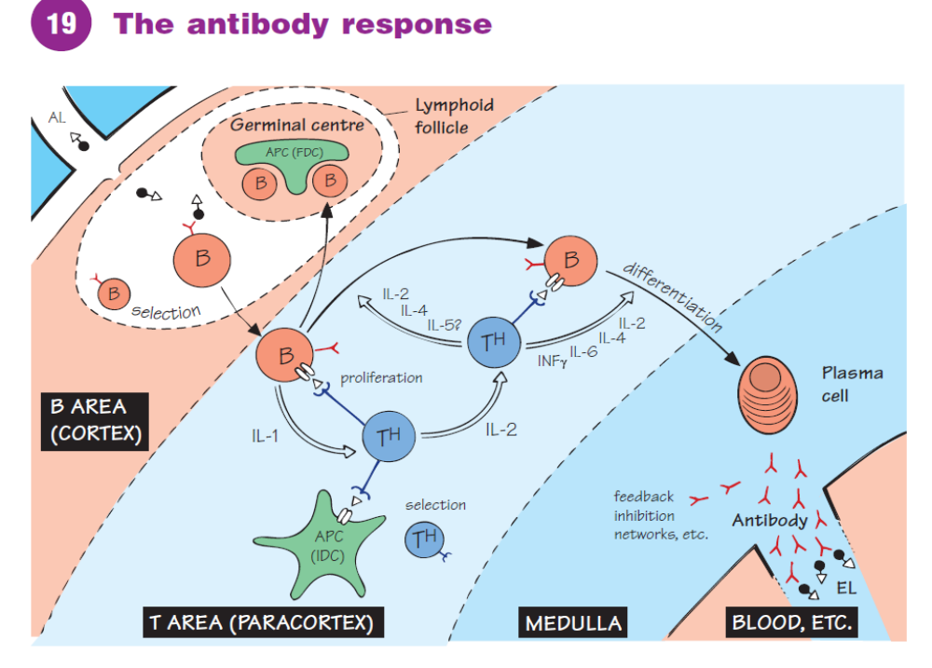

Slide 5
T-dep Ags
Dendritic cell maturation in response to a pathogen
Professional or specialized APC
Include: Dendritic cells, Macrophages and B cells
APC are found at all entry sites of Ags (airways, gastrointestinal tract or skin) and in lymphoid organs.
2 subsets of dendritic cells have been identified:
plasmacytoid synthesize the IFN α and β in the early phase of i.r. (innate immunity).
Myeloid dendritic cells have a major role in the induction of T cell i.r.
Characteristics of immature naïve dendritic cells:
a. present at all entry sites of the Ag and secondary lymphoid organs
b. express pattern recognition receptors such as TLR
c. Have large surface area
d. express phagocytic receptors to enhance engulfment of bacteria

Slide 6
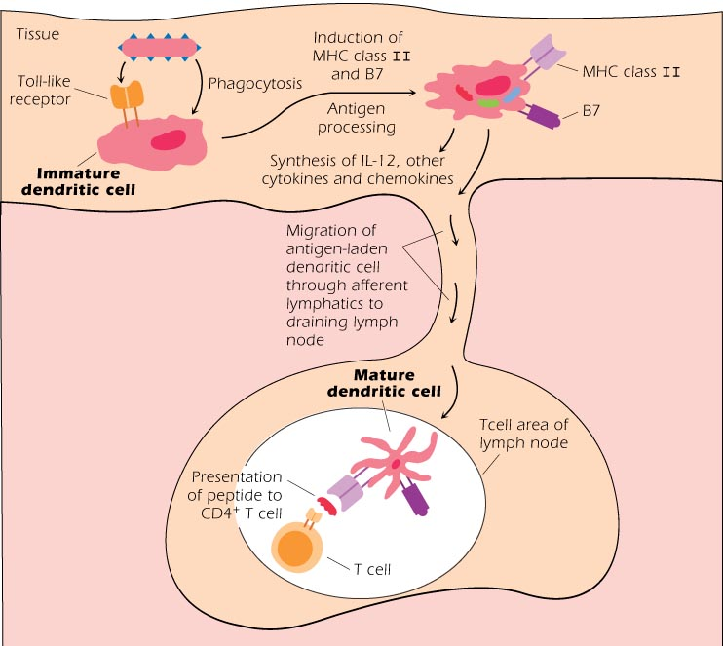

Slide 7
Maturation of naiive dendritic cells
1. attachment to the surface receptors
2. Engulfment of the Ag e.g bac
3. Ag processing: catabolizing the proteins into peptides in the endosomes following MHC class II pathway.
4. This induce
a. the expression of high levels of MHC class II and costimulatory molecules particularly B7
b. secretion of many cytokines including IL-12
c. upregulates the expression of chemokine receptor CCR7. CCR7L is expressed by high endothelial venules at the entrance of lymph nodes, the Ag-stimulated dendritic cells leave the tissue and migrate via lymphatics to the lymph node

Slide 8
Dendritic cell with self molecules in normal tissue does not lead to activation of either the dendritic cell or T cells
T cells and B cells to many harmless foreign Ags may evoke little or no immune response. For this reason, in vaccination an adjuvant is mixed with the Ag to enhance activation of APC

Slide 9
Activation of CD4+ T cells
1- Interaction of APC and CD4+ T cells
Activation of CD4+ cells occurs in the T cell area of L. node
occurs within 8-10 hours of Ag exposure

Slide 10
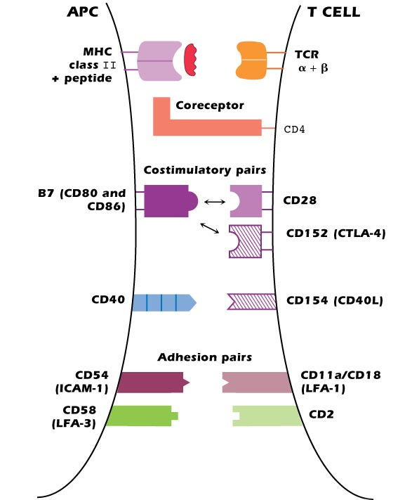

Slide 11
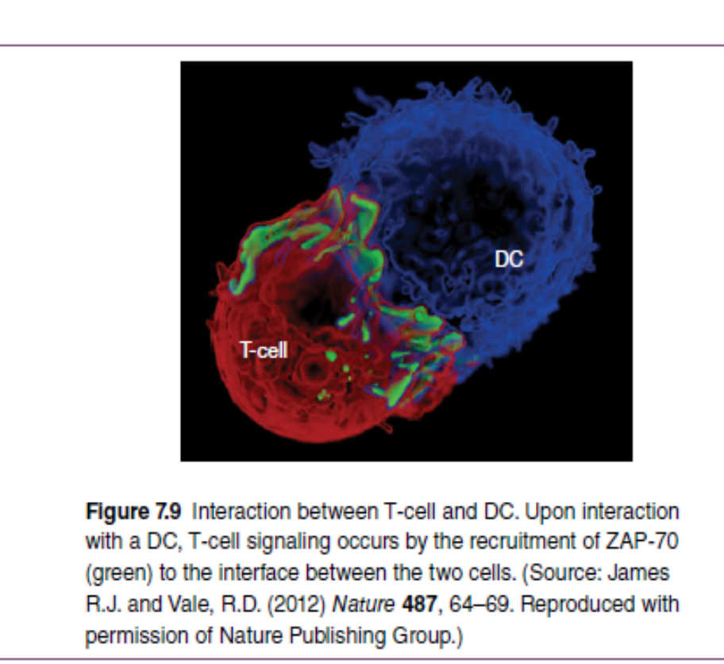
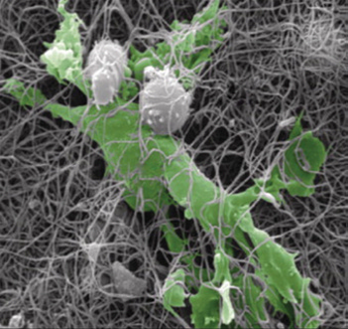

Slide 12
Formation of immunological synapse
The contact area between APC-peptide with CD4+ T cell is known as immunological synapse (i.s).
i.s is required for sustained intracellular signaling and lasting about 8 hrs.
Involve all costimulatory and adhesion molecules
i.s is dynamic : its composition and structure change with time after the initial contact e.g ICAM-1 and LFA-1 are found in different regions at different times
In the T cell membrane, the structure of lipid is not homogenous and form lipid rafts enriched in cholesterol and glycosphingolipid. Once T cell is activated, Lipid rafts are mobilized to the synapse participating in the intracelluar signaling

Slide 13
A-Peptide/MHC and TCR
  -The first signal involves interaction between the Ag-specific Vα+Vβ of TCR with peptide/MHC.
  -TCR detects very small number of foreign peptides as low as 4 peptide molecules out of thousands of peptides expressed on an APC, so the T cell is very sensitive to foreign Ag.
  -The interaction is of low affinity so it is necessary but not sufficient for the activation
  -The paired interaction enhance the affinity

Slide 14
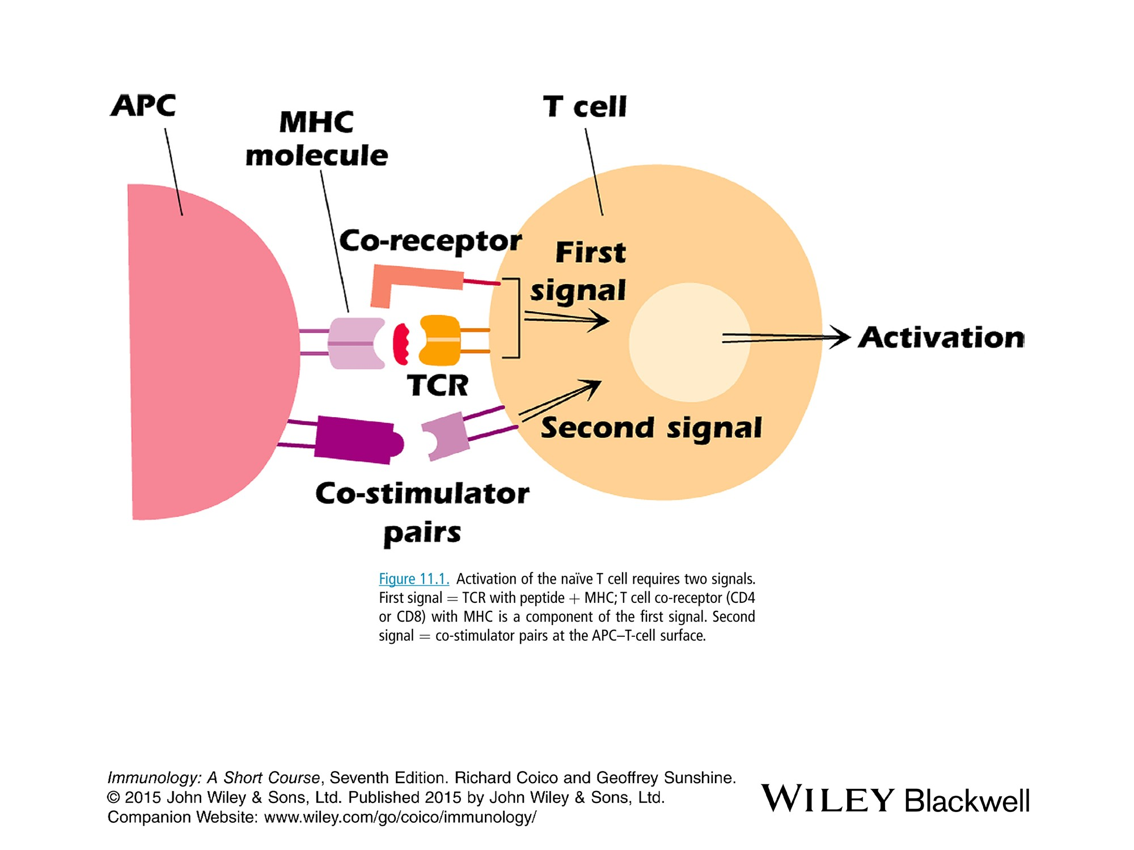

Slide 15
B-MHC class II with CD4 coreceptor
The interaction of the nonpolymorphic part of an MHC class II molecule with the coreceptor CD4 greatly enhance the ability of a T cell to respond to Ag and hence lowers the T cell Ag stimulating threshold.
The interaction makes a cell 100 folds more responsive to Ag than in the absence of the interaction
Also CD4 plays an important role in signal transduction
The requirement for two signals for T‐cell activation is a very good way of minimizing the likelihood that T‐cells will respond to self antigens.

Slide 16
c-Costimulatory Pairs
Deliver second signals that enhance and sustain the first signal
Ags that do not induce high levels of costimulator molecules do not activate T cells
B7 (APC) -CD28 (expressed constitutively on T cells)
In the absence of B7-CD28 interaction, the first signal alone not only is insufficient to activate the T cell but also results in T cell anergy.
treated with anti-B7
Resting T cell Anergic T cell(unresponsive to any further stimulation by Ag)
CD40 (APC)-CD40L (activated T cell):
The interaction upregulates T cell expression of CD40L and increase expression of B7
ICOS ligand (APC)-ICOS (T cells) necessary for the formation of germinal centers
D-Adhesion molecules
Strengthen and stabilize the interaction
ICAM-1 (APC)…LFA-1 (T cells)
LFA-3….CD2 (T cells)

Slide 17
2. Intracellular events in CD4+ T cell activation
The initial signal may involve the aggregation of multiple TCR molecules in the cell membrane.
This triggers multiple intracellular cascades that spread from the membrane through the cytoplasm and into the nucleus.
Some events occur within seconds, others within min. and others within hrs.
The T cell changes its pattern of gene expression from resting stage to an activated state.

Slide 18
Energy
Naive T‐cells
are constantly on the move, migrating through lymphoid tissues to patrol for signs of infection by endlessly sampling MHC–peptide complexes displayed by APCs.
This dynamism is extremely energy demanding and requires an efficient method of ATP generation while at the same time necessitating minimal new biosynthesis. Therefore, resting T‐cells use the oxidative pathway to convert the majority of their nutrient supply, in the form of sugar, fatty acids, and protein, into ATP.
Activated T‐cells
primarily use glycolysis to generate ATP even in the presence of oxygen, in a process termed anaerobic glycolysis.
activated T‐cells turn the majority of their nutrient supply into biomass to build an army of antigen‐specific daughter cells and crucial inflammatory mediators with which to fight an infection. Blocking the oxidation of lipids to favor fatty acid synthesis to build cell membranes.

Slide 19
The transcription factor c‐Myc
plays a crucial role in regulating glycolysis. c‐Myc expression of essential glycolytic genes, The importance of glycolysis for T‐cell activation is illustrated by the fate of c‐Myc‐deficient T‐cells, which are completely incompetent for glycolysis and fail to proliferate on antigen stimulation.
In contrast to effector T‐cell differentiation , Treg and memory T‐cells have a lower requirement for proliferation and as such, these cells rely mainly on fatty acid oxidation for energy, with minimal dependence on glycolysis

Slide 20
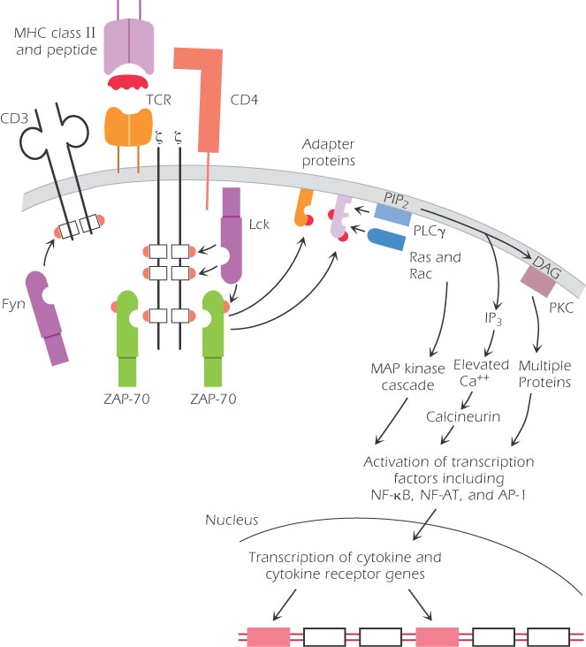
Notes:
6

Slide 21
After binding of TCR, activation of CD45 mem protein Tyr phosphatase occurs which in turn activates within seconds of Tyr kinases ,fyn )associated with the cytoplasmic tail of CD3) and lck (associated with the cytoplasmic tail of CD4). Both fyn and lck belong to src family of Protein Tyr kinases (PTK).
The phosphorylated ITAM in CD3 than act as docking sites for another Tyr Kinase ZAP-70 (syk family). Activation of ZAP-70 is a critical step.
(zetachain associated protein of 70 kDa),
2 adaptor molecules become phosphorylated thus a multiprotein complex of s. transduction molecules is assembled in sequence
The adaptor molecules bind phospholipase c-γ which in turn catalyze the breakdown of the mem phospholipid phosphatidylinositol biphosphate (PIP2) into diacylglycerol (DAG) and inositol triphosphate (IP3).

Slide 22
DAG activates the mem-associated Protein kinase C (PKC) which in turn activates a cascade of kinases, ultimately leading to the activation of cytoplasmic transcrption factor, NF-кB.
IP3 increases the free Ca levels, which in turn activates the calcineurin protein which activates the transcription factor NF-AT.
Cyclosporin A and tacrolimus used to prevent graft rejection bind to calcineurin and prevent T cell activation.
In addition, adaptor molecules activate guanosin binding proteis, Ras and Rac which in turn activate mitogen-activated protein kinase (MAP) leading to the activation of the transcription factor AP-1.
Ras is a small G‐protein that is constitutively associated with the plasma membrane and is frequently activated in response to diverse stimuli that promote cell division. It can exist in two states: GTP‐bound (active) and GDP‐bound (inactive).

Slide 23
The raised Ca2+ concentration within the T‐cell has at least two consequences:
First, it synergizes with DAG to activate protein kinase C (PKC);
second, it acts together with calmodulin to increase the activity of calcineurin, a protein phosphatase that can promote activation of an important transcription factor(NFAT) required for IL‐2 production.
The expression of Fos, a transcription factor results in the formation of heterodimer to form the AP‐1 complex that has binding sites on the IL‐2 promoter as well as on many other genes.
Deletion of AP‐1 binding sites from the IL‐2 promoter abrogates 90% of IL‐2 enhancer activity

Slide 24
3-Subsets of CD4+ T cells
4 major subsets of CD4+ cells are known according to the secreted cytokines:
T_{H0,} T_{H}1, T_{H}2, T_{H}17, Tfh and T_{reg} cells
T_{H}0 cells: Have some features of both T_{H}1 and T_{H}2 cells, synthesizing IL-2, IL-4 and IFN-γ
T_{H}1 cells:
As a response to intracellular pathogens, dendritic and NK cells produce IL-12 which in turn activates the transcription factor Stat4 and Stat1 & T-bet
synthesize IFN-γ, IL-2, TNF-β (lymphotoxin)
these cytokines activate Macrophages, CD8+ T cells and NK cells to kill the intracellular pathogens Characteristics of CMI.
IFN-γ influences B cell class switching to Ig isotypes.

Slide 25
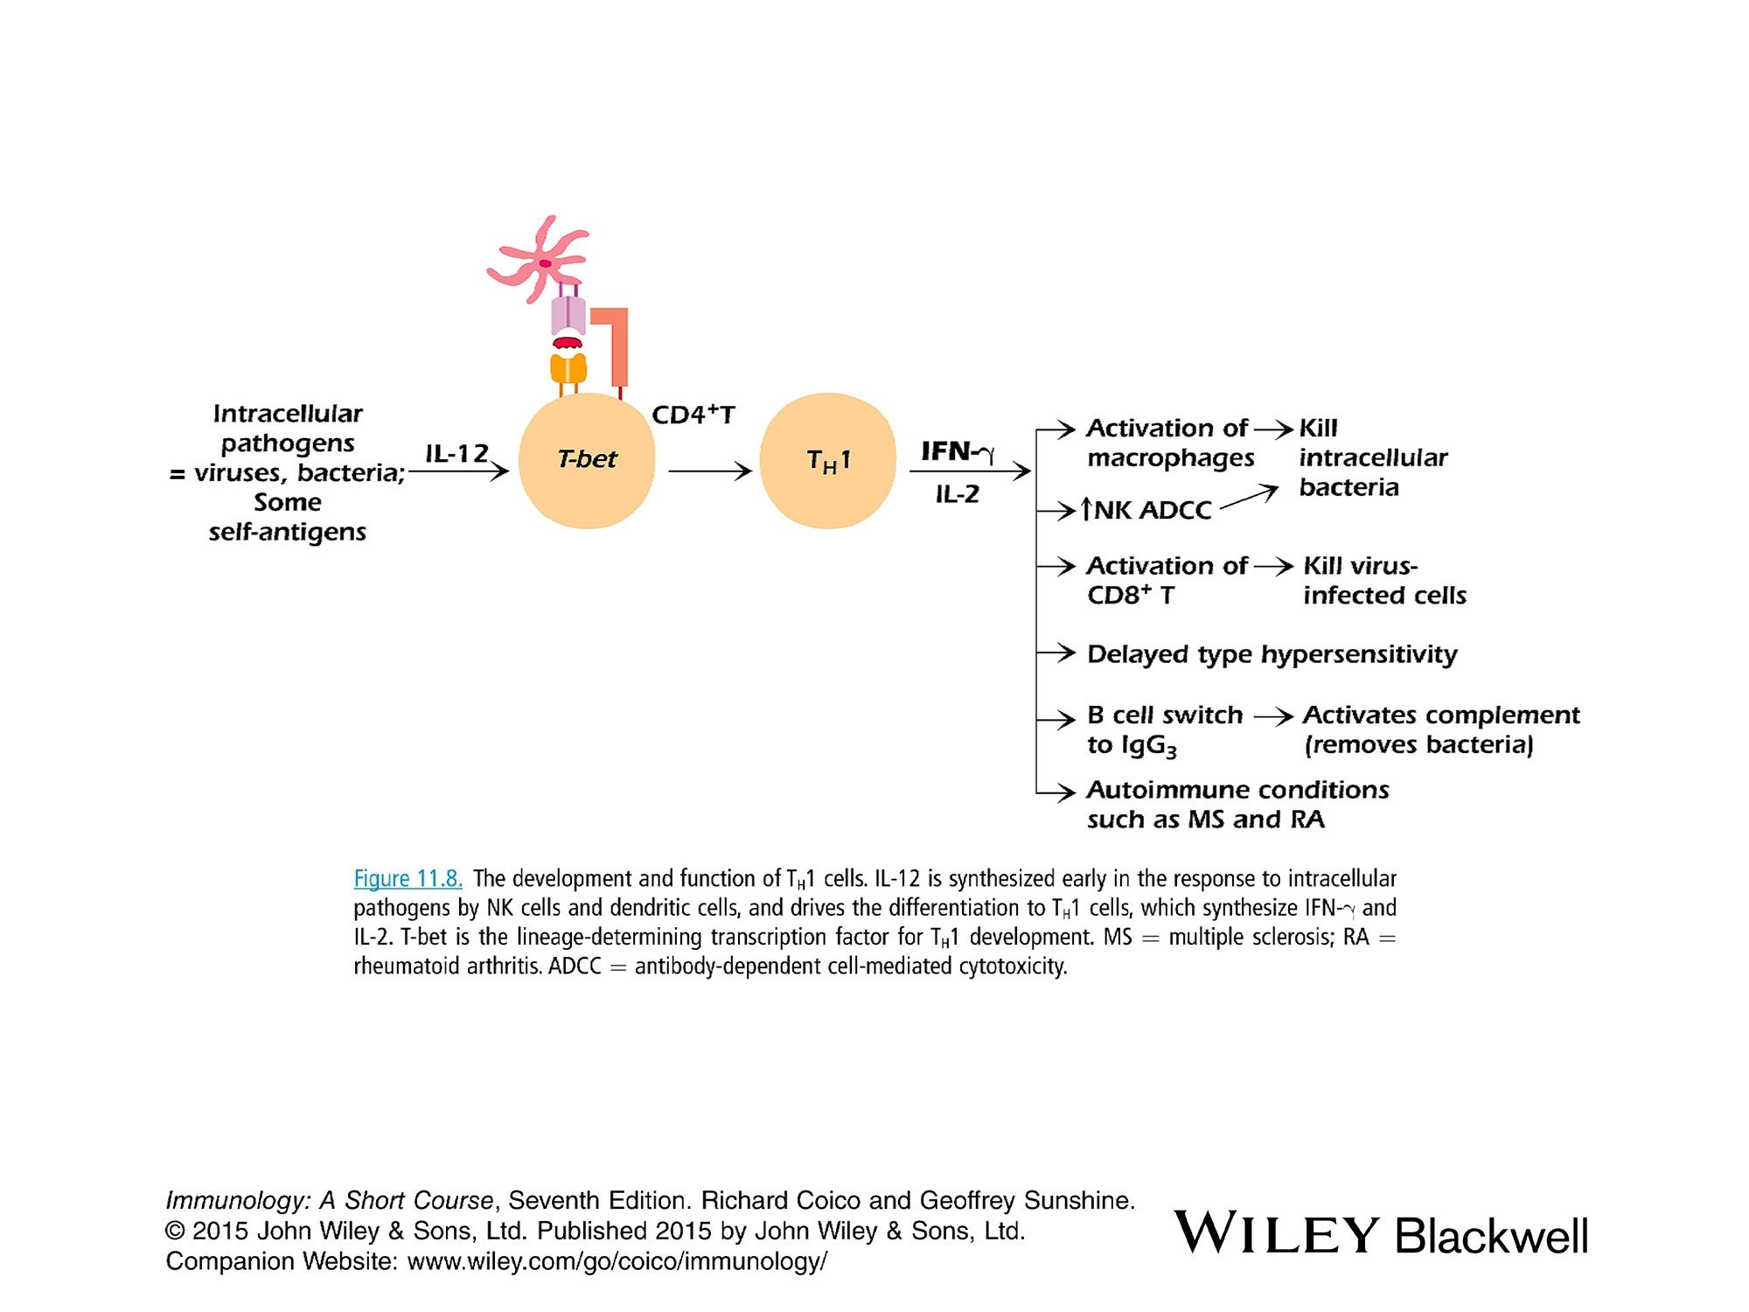

Slide 26
T_{H}2 cells
Develop in the presence of IL-4 as a response to parasitic worms such as Helminthes and allergens, produced by mast cells, activated CD4+ T cells, and NKT cells
IL-4 activates Stat6 & GATA of T cells
The role of GATA3 in Th2 cell differentiation is highlighted by the complete failure of GATA3‐deficient mice to generate a Th2 response.
synthesize IL-4, IL-5, and IL-13
IL-4, and IL-13 influence B cell class switch to IgE and IL-5 activates eosinophils, both characterize immune response to parasitic worms and type 1 hypersensitivity (allergy).

Slide 27
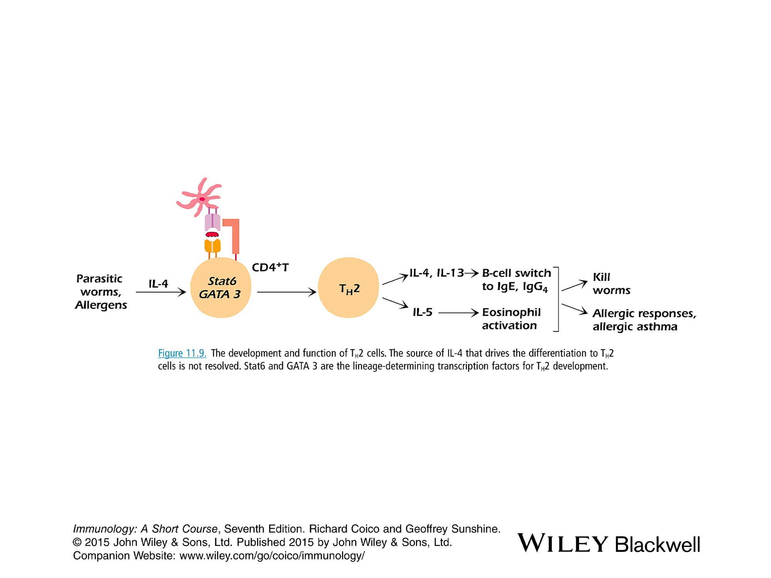

Slide 28
T_{H}17 cells:
1-synthesize IL-17 and IL-22 cytokines.
A. IL-17 and IL-22 are pro-inflammatory or they promote inflammatory response.
activate and recruit neutrophils and EC that secrete IL-1, IL-6 and TNF-α.
B. Th17 have been described in some autoimmune diseases (Rheumatoid arthritis, multiple sclerosis).
2-Involved in responses to extracellular bac (klebsiella pneumonia) and fungi (Candida albicans). T_{H}1 and T_{H}2 have little effect on these pathogens.
3-Express high levels of receptor activator of NF-B ligand (RANKL) that actvate osteoclasts which stimulate degradation of bone matrix

Slide 29
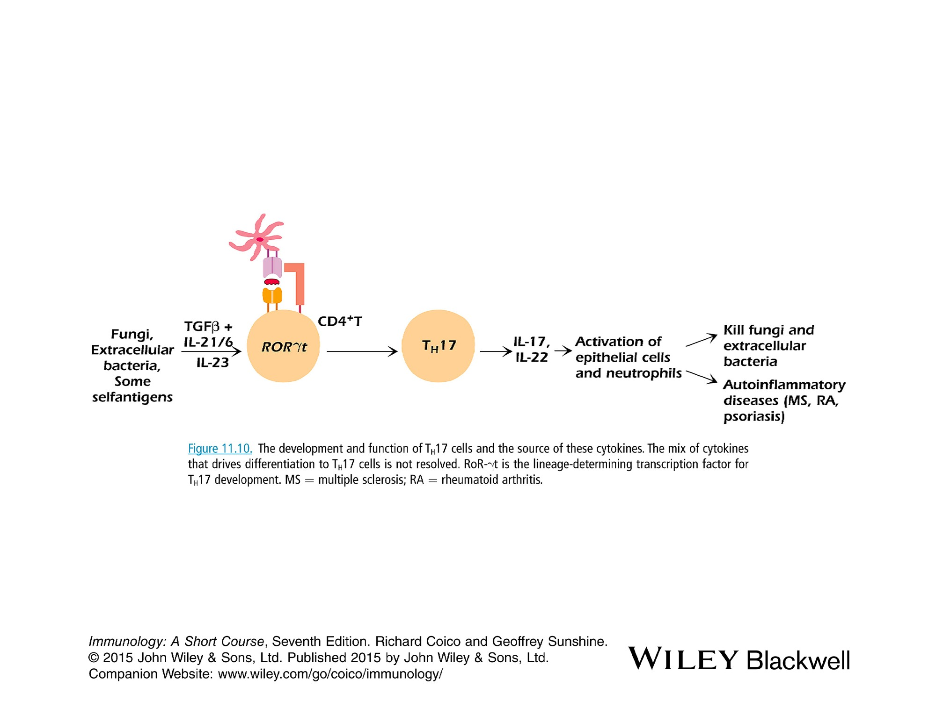

Slide 30
T_{reg} cells: subset of CD4+
Express CD25 and CTLA4
suppress the differentiation of other CD4+ subsets. They suppress also dendritic and B cells.
Suppress immune response directed against self molecules (Tolerance) and against foreign Ags (regulation). Lacking of T_{reg} cells (defective Foxp3 gene) results in autoimmune diseases like the x-linked IPEX syndrome and allergy.
This inhibitory action is due to secretion of inhibitory cytokines, IL-10 and TGF-β

Slide 31
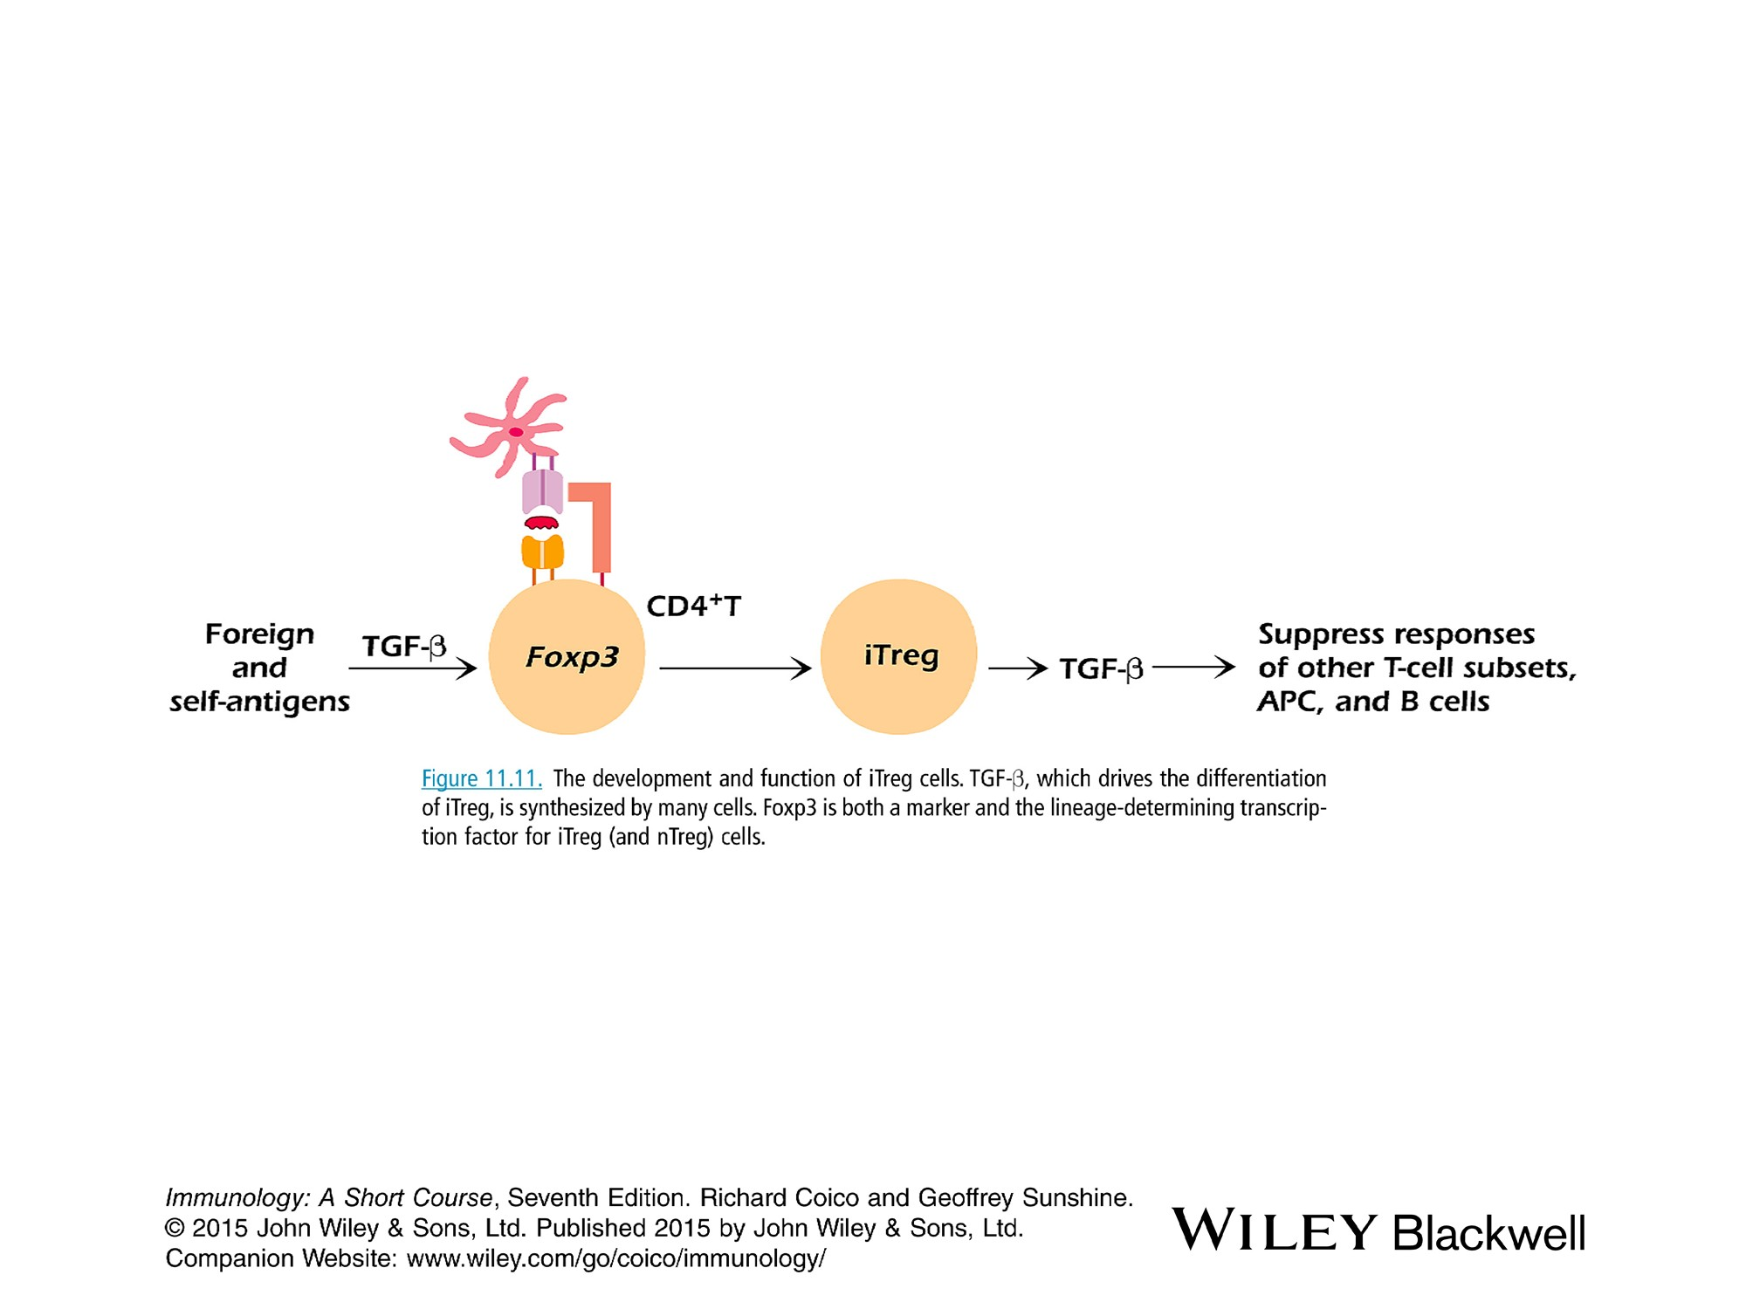

Slide 32
XX T folicular helper cells (Tfh)
Tfh differentiation usually starts with interaction of a naive CD4+T cell with an (APC) . Tfh differentiation can largely be modeled as an early cell fate decision between becoming aTfh cell and a non-Tfh effector cell, e.g., Th1, Th2, or Th17 cell.
Tfh cells stay resident secondary lymphoid organs in lymph nodes and spleen because their purpose is to help B cells,
while non-Tfh effector cells such as Th1, Th2, Th17 cells are destined to predominantly leave lymphoid tissue and traffic to sites of infection or inflammation as actions at those sites are the primary purposes of most non-Tfh cells
Tfh cells are a unique lineage of CD4⁺ T cells that express the master TF (Bcl-6). They are phenotypically characterized by surface expression of (CXCR5) and (PD-1), as well as production of (IL-21).
While proper development of Tfh cells is critical for establishing strong humoral immunity, abnormal Tfh immune responses have been associated with autoimmune diseases

Slide 33
XX
Tfh Th1
Function B cell help Tissue Inflammation & antimicrobial
Line defining TF Bcl6 Tbet
Localization LN and spleen infected tissue
Blimp-1 ---- +++
CKs IL-21, IL-4, CXCL13 INF-y
B cell-dep +++ -----
Bcl-6 suppress Blimp-1 and Blimp-1 suppress Bcl-6

Slide 34
XX
Cross-inhibtion of CD4+ cells
CK produced by one subset of CD4+ T cell inhibit the function of other subset.
1. IFN- γ synthesized by Th1 cells inhibits the development and function of Th2 and TH17 .
2. IL-4 synthesized by TH2 cells inhibit TH1 and TH17 cells
3. T_{reg} cells inhibit all the other TH1, TH2 and TH17 cells

Slide 35
3-IL-2 synthesis and proliferation
Activated transcription factors enter the nucleus of the activated T cell and bind selectively to regulatory sequences of several genes.
Two activated genes (within 24 hrs) are the IL-2 and IL-Rα (CD25) are transcribes and translated directly after B7-CD28 interaction.
IL-2 is a T cell growth factor and act on the same cell or adjacent T cell
The resting naive T cell expresses 2 chains β and γ of the IL-2R with low affinity. The synthesis of the IL-2Rα chain due to activation converts the IL-2R into 3-chain high affinity R.
Interaction of IL-2 with IL-2R results in enlargement of CD4 T cell and proliferation (within 24-48 hrs after initiation of activation). This expansion is noted as a swelling of lymph node

Slide 36
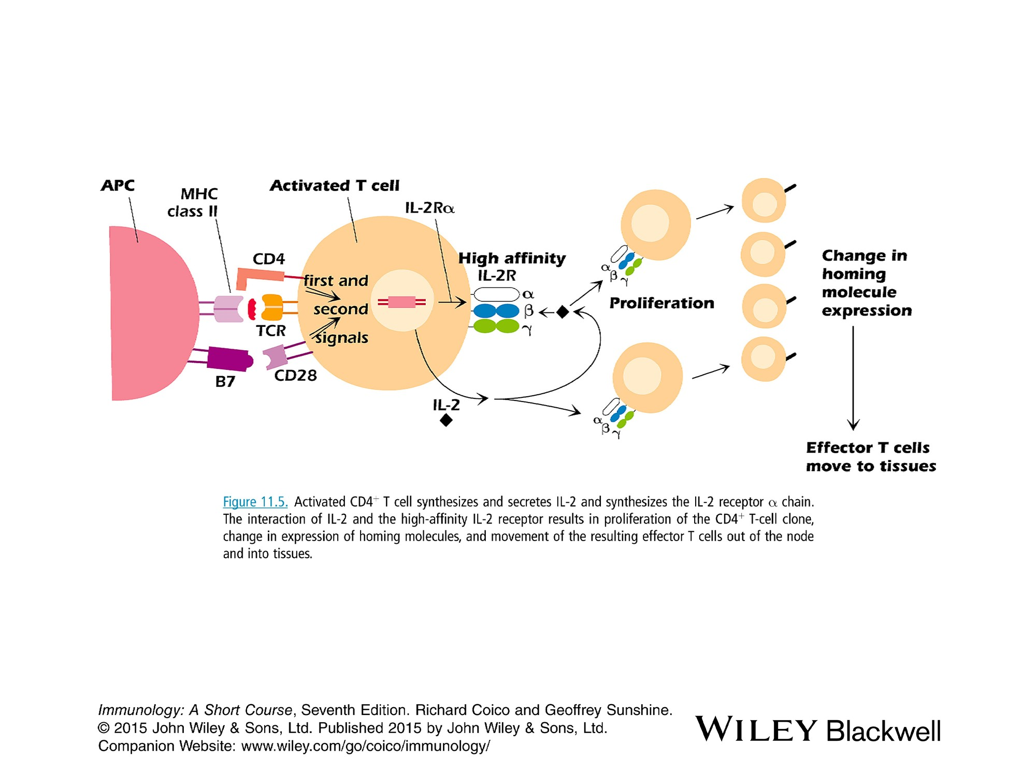

Slide 37
Clonal expansion and differentiation to effector cells
As a result of secreted CK, enormous expansion of the original clone of Ag-specific cells up to 10,000 times the original clone size. This cause swelling of the L. node in which the response occurs.
The activated T cells differentiate into effector T cells. Activation of T cells result in a change in expression of adhesion molecules and chemokine R.
A. Effector cells down-regulate the adhesion molecules L-selectin and CCR7 that allow the naïve T cells to enter the node.
B. They up-regulate the adhesion molecules (integrin) and CCR10 that allow them to migrate out of the node to locations infected by pathogens.

Slide 38
B cell selection
Generally, BCR recognize s and binds free Ag in solution. Protein, polysaccharides or lipids may act as an Ag. The Ag that penetrate into tissues is carried to the lymph node draining the tissue.
Thus, B cell epitopes are hydrophilic. Terminal side chain of Polysaccharides and hydrophilic portion of a protein molecules constitutes B cell epitopes (sequential) and conformational epitopes due to folded conformation of a protein.
Among the trillions of different B cells, the Ag interacts in the L. node follicle (cortex) with a B cell expressing a specific BCR. The selected B cell moves to the T cell area (paracortex). The B cells that participate in response to an Ag, are called follicular B cells.
The B cell captures Ag and presents it to the activated TH cell.

Slide 39
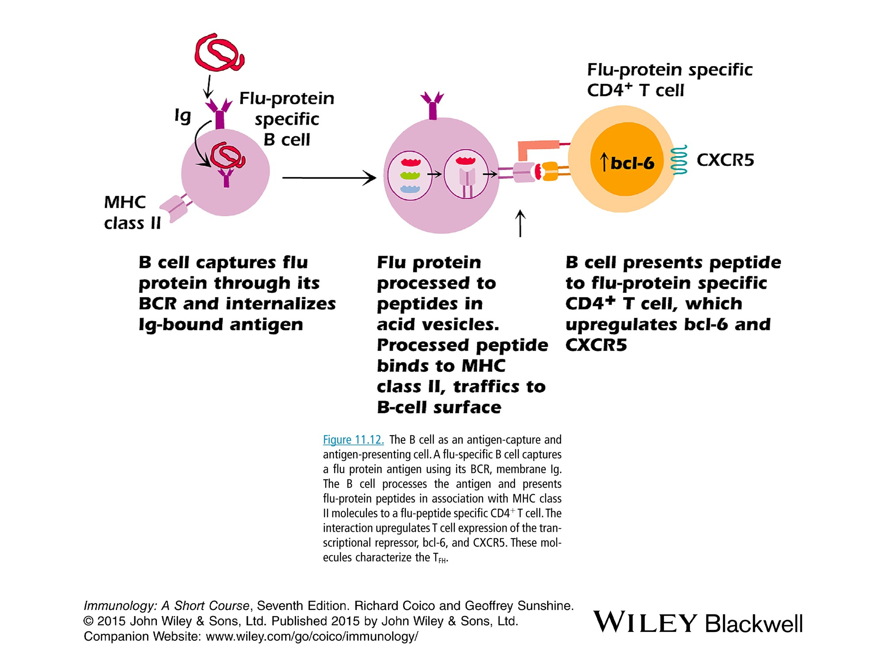

Slide 40
Cooperation between selected activated CD4+ and B cells
Development of T_{FH T} folicular helper
Characteristics:
express the transcription factor Bcl-6, the chemokine receptor CXCR5 and secrete IL-21
CXCR5 is the marker for germinal center development and T-B cooperation

Slide 41
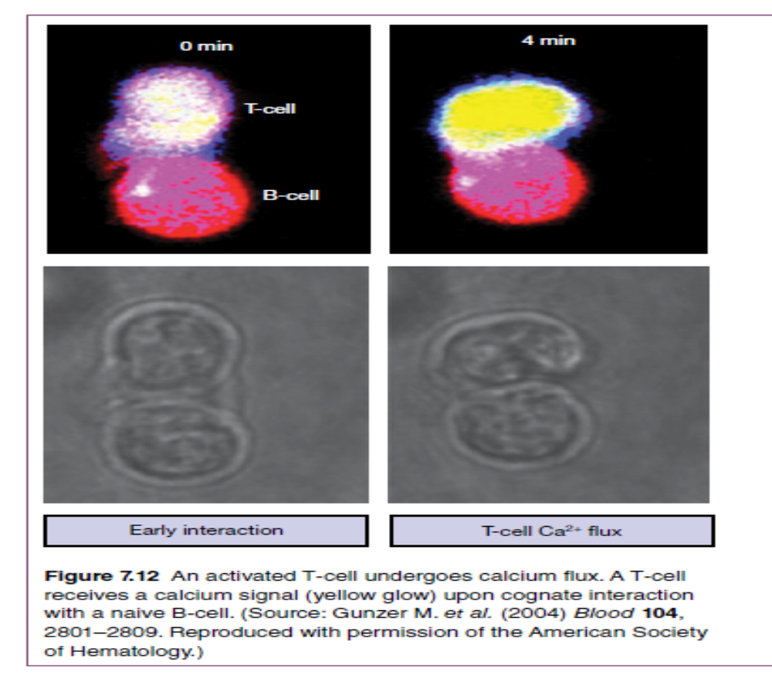

Slide 42
B. Paired interaction APC and CD4+cell
The interaction between B-T is similar to that between APC and CD4+ T cell.
-Peptide/MHC on the B cell….TCR on T
-Costimulatory molecules: B7---CD28, CD40---CD40L, ICOS--ICOSL
-Adhesion molecules
1. This interaction upregulate T_{FH} cytokine synthesis which in turn affect the T cell itself and the B cell. IL-21 the signature cytokine of T_{FH} cells promote survival and proliferation of both T_{FH} and GC B cell and direct class switching e.g IL-4 promote IgG4
2. The CD40-CD40L interaction appears critical in the activation of B cells. It is required for class switching. In hyper-IgM syndrome, boys with a nonfunctional CD40 or CD40L produce IgM Ab but no other isotype.
3. People who lack a functional ICOS gene product do not develop normal germinal centers and are immunodeficient.

Slide 43
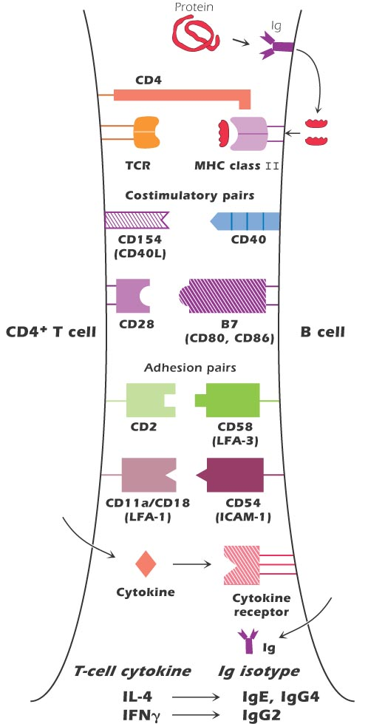

Slide 44
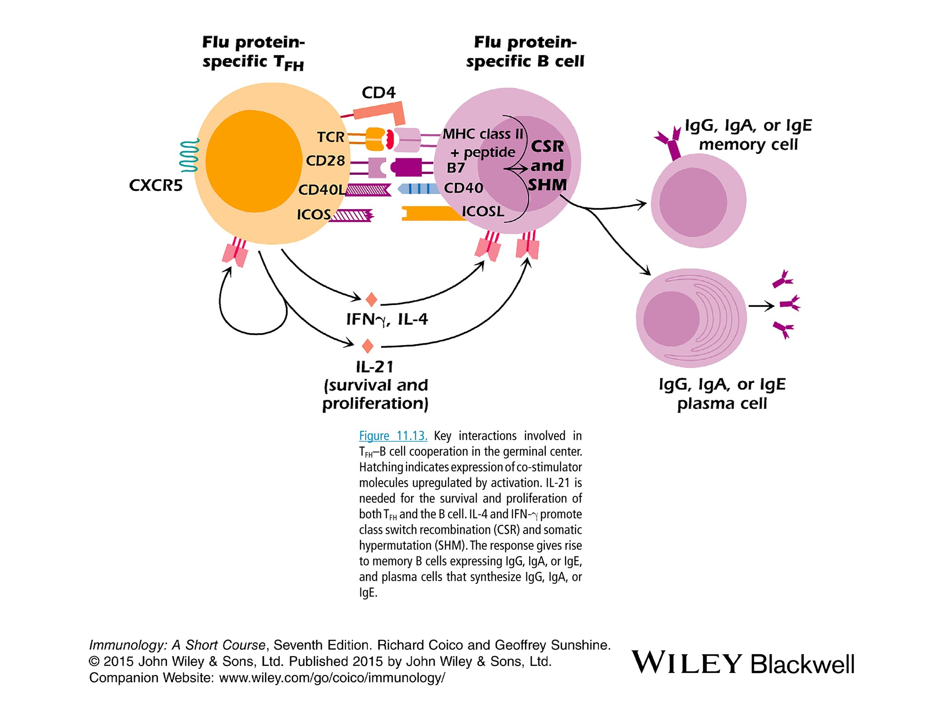

Slide 45
C. Linked recognition
The Th cell and B cell that cooperate in a response to a particular TD Ag must both be specific for that Ag. They may respond to different epitopes of the same Ag. T-B cooperation is known as linked recognition.
Linked recognition is the principle of conjugated vaccines. The marginal zone B cells do not develop untill a child is about 2 years old. So young children are susceptible to infections from H. influenzae and S pneumonia. Purified polysaccharide from the bac is physically linked to a carrier protein as tetanus toxoid

Slide 46
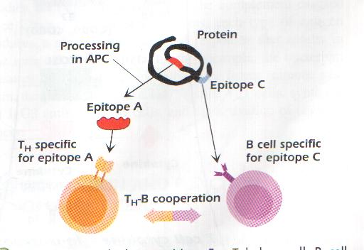

Slide 47
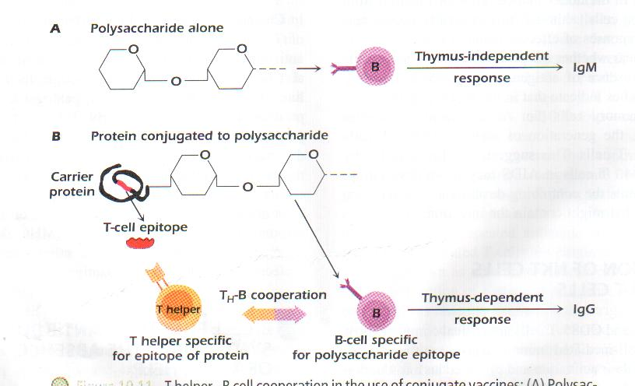

Slide 48
Intracellular pathway in B cell activation
The first signal includes interaction between the Ag and the BCR. The associated Igα and Igβ serve like CD3 and CD4 as t.d. molecules that activate Tyr kinases Lyn, Fyn and Blk. This in turn activates another kinase Syk which plays a central role in B cell activation.
The subsequent reactions resemble that for CD4+ T cells. Adaptor molecules, PL-γ, DAG, IP3, Ras, rac, MAP kinase.
The transcription factors NF-кB , NF-AT, AP-1 enter the nucleus and activate several genes for Ig and CK receptor genes.

Slide 49
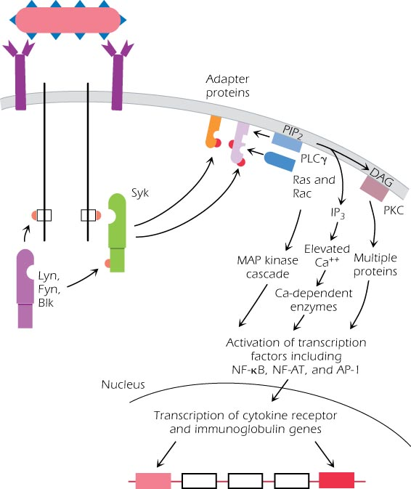

Slide 50
7-Events in the germinal centers of activated B cell
In the germinal center, the B cell undergoes:
1. somatic hypermutation in which B cells with Ig variable region genes that synthesize Ab with higher affinity for the activating Ags are selected.
2. Class switching
3. Plasma cells and memory cells are developed
In the absence of antigen, B‐cells within lymph nodes reside primarily within primary follicles composed of a mesh of follicular DC (FDCs), the spaces between which are packed with resting, small B‐lymphocytes.
However, upon encounter with T‐dependent antigen, the primary follicles undergo a transformation into secondary follicles, as antigen‐specific B‐cells undergo rapid clonal proliferation and crowd around the FDC network.

Slide 51
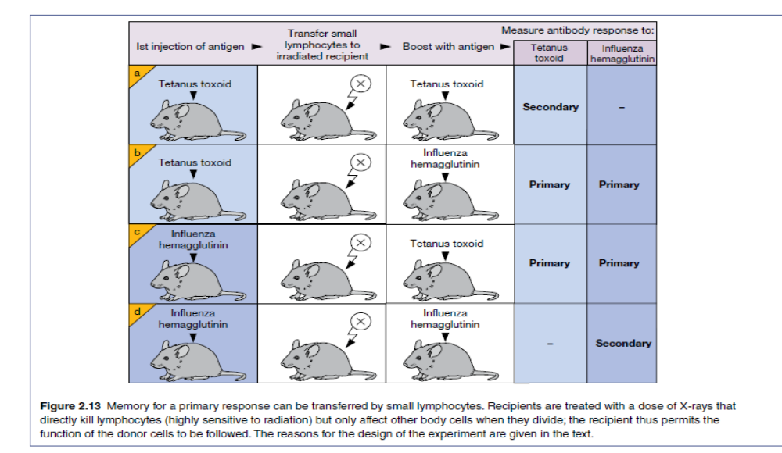

Slide 52
T-Independent B cell response
Most Ags are known as thymus-de. (TD) Ags because they require Th cells. The thymus-indep Ags (TI) the responding B cells do not require Th cells.
Features of i.r
a. i.r occurs in people or animals that lack a functional thymus or T cells (immunodeficiencies).
b. generate IgM and do not give rise to memory cells.
c. cross-linking of BCR with the repetitive epitopes directly activates the B cells
TI Ags are divided into 2 classes:
TI-1Ags: repeating structure
mitogenic at high conc.
polyclonal activator e.g LPS of G- bacteria like E. coli
The protein coat of some viruses as polio virus
TI-2 Ags: are not mitogenic at high conc.
like bac and fungal polysaccharide as dextran, ficoll capsule polys. Of
Hemophilus influenzae and Strep pneumonia

Slide 53
9-Other ways to activate B or T cells
1. SuperAgs;
Bac toxins as S aureaus.
Activate CD4+ cells expressing a particular V molecule as one chain of TCR, regardless of chain.
a high % of T cells of various specificities may become activated in the presence of superAg. The massive release of CK following SuperAg can result in injury to the host.
2. Plant proteins :
Polyclonal activators for B cells include LPS
Polyclonal activators for T cells include : the plant glycoproteins Phytohemagglutinin (PHA) and Concanavalin A (ConA) which are lectins.
Polyclonal activators for B and T cells include: pokeweed mitogen (PWM).
Because the B or T-cell response of healthy human blood to LPS or ConA (PHA) falls in a well-defined range, a low response frequently indicates that a person is immunosuppressed.
3. Antibodies: Abs against CD3 activate T cells to proliferate.

Slide 54
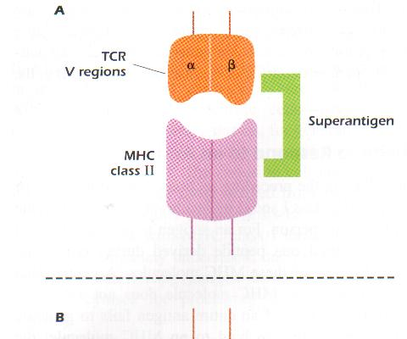

Slide 55
10-Modulation of BCR Signal
Positive modulation
Like coreceptors of TCR (CD4 or CD8), the BCR coreceptors (CD81, CD21, CD19) decreases the amount of Ag needed to trigger the B cell (decrease the threshold) 100-1000 fold
Microbial pathogens activate the complement system and become coated with complement component C3dg. The R for C3dg is CD21.
Thus the pathogen bound to C3dg becomes attached via CD21 to the B cell. The cross-linking of BCR-Ag-C3dg-CD21 deliver an activating signal to B cellthrough phosphorylation of CD19.

Slide 56
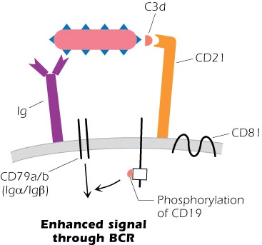

Slide 57
11-Negative modulation
a. CD28----CTLA4
CTLA4 competes with CD28 for B7 binding and has a higher affinity than CD28, the cytoplasmic domain has ITIM motif, and turns off the production of IL-12
b. Programmed cell death protein PD-1
-expressed on activated T cells.
-Inhibit ZAP-70 function
-Binds to PDL (expressed on most tumor cells and many normal cells)
-Transmit negative signals into T cells.
-used in clinical trials to treat some autoimmune diseases

Slide 58
like CTLA‐4, PD‐1 is involved in the suppression of T‐cell‐driven immune responses. Unlike CTLA‐4. however, deficiency of which leads to fatal autoimmune disease in mice.
PD‐L1 is expressed at significantly high levels on many tumor types, which is correlated with poor clinical prognosis. This indicates that tumor cells may aggressively express PD‐L1 on their surface to block CTL‐mediated killing.
Many PD‐1/PD‐L1 blocking therapies are now in advanced phase clinical trials and have shown impressive clinical responses in multiple tumor types.
The Nobel Prize in Medicine 2018 Awarded for Discovery of CTLA-4 and PD-1

Slide 59

The Nobel Prize in Medicine October, 2018 Awarded for Discovery of CTLA-4 and PD-1
Tasuka Honjo, Japan
James Allison, USA

Slide 60
XX c. CD32 on B cells
The produced Ab after overcoming the Ag inhibits a further B cell response to that Ag.
-can be induced by injection of Ab into an individual shortly before or during an i.r.
-This property has been used to treat Rh incompatability reaction
-IgG aggregates or Ag-Ab complexes interact with the low affinity FcγR (CD32) expressed on B cells.
The BCR-Ag-Ab complexes-CD32 gibe rise to a negative signal . This activates a phosphatase to the Tyr of the intracellular portion of CD32 (ITIM) that removes the phosphate leading to an inhibitory signal

Slide 61
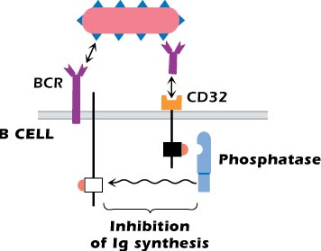

Slide 62
Activation and Function of CD8+ T cells: Cell-mediated Immunity

Slide 63
Activation of CD8+ T cells
A. Activation and Function of CD8+ T cells
B. CD4-Independent activation of CD8+ T cells
C. CD4-dependent activation of CD8+ T cells
D. Killing of target cells by CD8+ T cells
E. Termination of the CD8+ T cell response
F. The traffic of activated CD8+ T cell
G. γδ cells
H. NKT cells

Slide 64
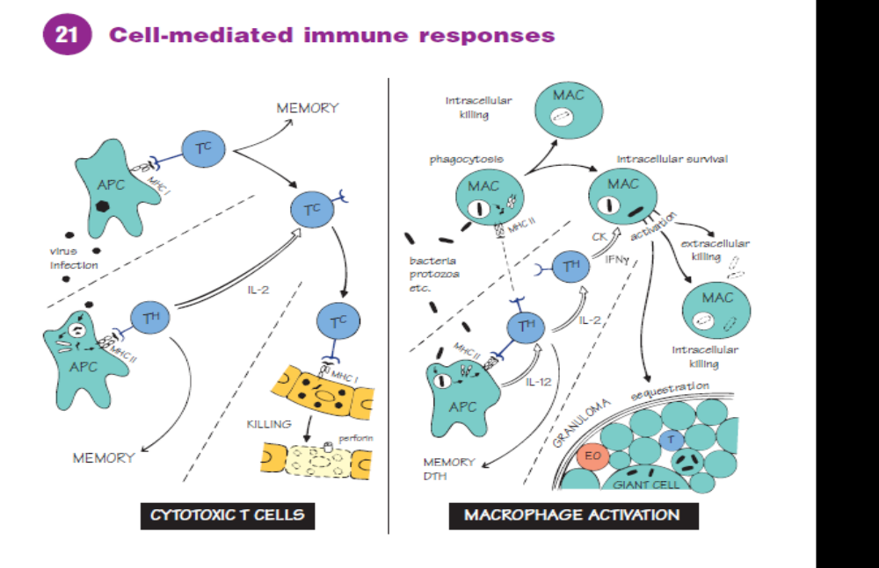

Slide 65
Activation and Function of CD8+ T cells
The principle function of CD8+ T cell is to kill host cells that have been infected by viruses and bac.
Also involved in killing transplanted foreign cells and tumor cells.
Therefore, CD8+ T cell is referred to as Cytotoxic T lymphocyte (CTL).
The target cell can be any cell in the body.

Slide 66
Generation of Effector CD8+ T cells
Two pathways are known for the activation of CD8+ T cells by viruses, T-dep and T-indep
CD4+T-indep
A DC can present a virus-derived peptide associated with an MHC class I molecule.
DC provides the first (peptide/MHC…TCR) and second signal (costimulatory molecules) as well as secretion of IL-12 to activate CD8+ T cell.
The CD8+ T cell synthesize IL-2 that induces proliferation of the activated T cells.

Slide 67
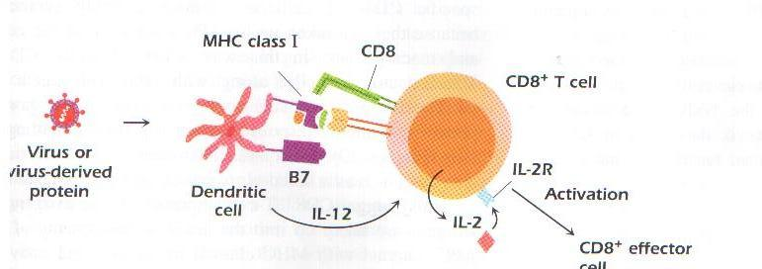

Slide 68
CD4+T-dep activation of CD8+ T cell
A DC that has taken the virus as an exogenous Ag presents virus-derived peptides in association with MHC class II molecules to a virus-specific CD4+T cell. Activated CD4 T cell proliferate and synthesizes IL-2.
The same or another DC may also present viral Ags to CD8+ T cells in association with MHC class I molecules.
The virus epitope that activates CD4+ T cell is different from the epitope that activates the CD8+ T cell.
The third signal involve secretion of CK that induce proliferation and activation of the selected CD8+ T cell
Intracellular activation of CD8+ T cell is the same as CD4+ T cell include the Tyr Kinases (Fyn, Lck, ZAP-70, and others).

Slide 69
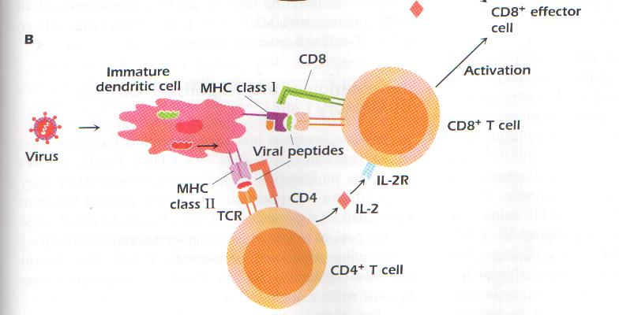

Slide 70

CD8+ T cell –Killing of target cells
Cell to cell contact:
Once activated, the CD8+ T cell initiates killing by attaching to the target cell.
Unlike naive CTL which circulate only through lymph nodes and other secondary L. organs, activated and memory CTL can enter tissues.
The cell to cell contact is critical for the killing process. In agar immunodiffusion experiment, if the activated CD8+ T cells are put in a well and the other well is filled with the target cells, no killing will be achieved.
The paired adhesion molecules expressed on the T cell and target cell surfaces help to maintain contact for several hours.

Slide 71
Killing occurs by 2 pathways:
Cytotoxic granules by activated CD8+ T cell: the predominate killing pathway.
After attaching to the target cell, the T cell reorganizes its internal structure so that the granules are close to the area of contact. T cells release the granule contents by exocytosis. The major constituents are:
Perforins: are transmembrane channels form pores in the target cell membrane similar to complement system.
Granzymes: are ser proteases that pass into the target cell through the pores. Granzymes interact with intracellular components and induce apoptosis.
Granulysin: small protein that enter the target cell that kill the intracellular pathogens such as Mycobacteria and Listeria.
kills human tumor cells by initiating a cascade of intracellular events that involve the influx of calcium and apoptosis

Slide 72
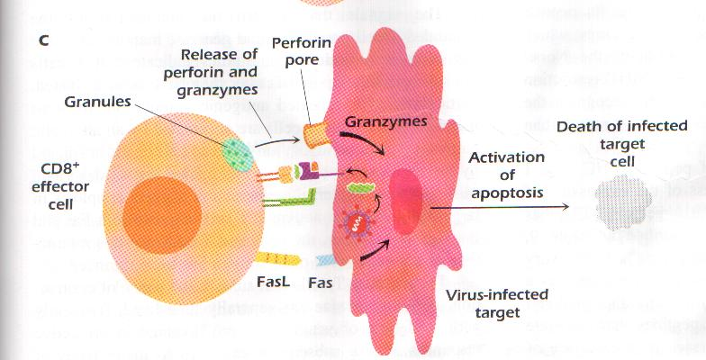

Slide 73
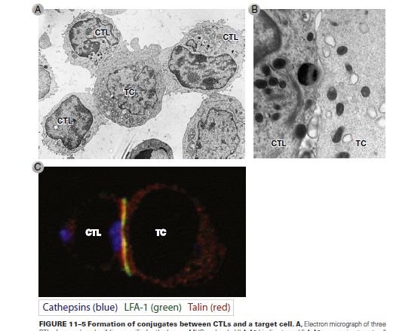

Slide 74
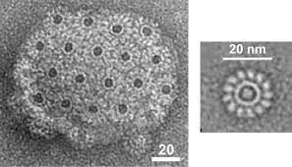
MAC

Slide 75
Fas-FasL interaction:
A second killing pathway
Fas: surface molecule expressed on many host cells
FasL: expressed on activated CD8+ T cell
This interaction activates apoptosis of the target cell via a sequential activation of caspases (a proteolytic enzymes inside the target cell). The cell dies within hours.
Although the secretion of perforin and granzymes is the main way by which CTL eliminate infection, with the expression of Fas ligand playing a lesser role, most CTL also release the cytokines IFN-γ, TNF-α, and TNF-β.

Slide 76
MHC restriction and CD8+ T cell killer function
MHC restriction: CTL recognizes the combination of Ag (peptide) plus MHC molecules rather than Ag alone.
A virus-specific CD8+ CTL recognizes and subsequently kills a target cell expressing a specific combination of viral peptide and a particular MHC class I molecule.
A CD8+ CTL specific for a flu virus peptide and HLA-A2 kills a target cell expressing HLA-A2 that has bound the flu-derived peptide.
In the absence of the flu peptide, this CTL does not kill uninfected or normal cells from an individual expressing HLA-A2. In addition, this virus-specific CTL does not kill targets expressing different combinations of peptides plus MHC molecules such as measles-virus derived peptide bound to HLA-A2 or even the flu peptide bound to different HLA molecule.

Slide 77
Killing of any infected cell:
The recognition occurs regardless of the expression of any MHC class II molecule by the target cell. MHC class I are expressed on almost every cell in the body.
Since the infection pathogen may infect any nucleated cell, a pathogen generates peptides that associate with MHC class I molecules. Thus, killing by CTL provides a mechanism to eliminate any cell in the body that becomes infected with a pathogen.
Elimination of the pathogen results in the destruction of host cells, but this is the price the individual pays for removal of the source of the infection.
Killing by apoptosis prevent the spread of the virus into other cells.
The killing is logarithmic as the T cell detaches from the target cell to attack and kill additional target cells.
Harmless or noninfectious Ags do not generally trigger CTL response. In contrast, intracellular pathogens evoke CTL (CD8+) and Th (CD4+) cells and induce Ab synthesis

Slide 78
Memory T cells
Ability to survive in a quiescent state after Ag is eliminated. Naïve cells live for weeks but memory cells survive for months or years
The No of specific memory T cells is greater than the No of specific naïve cells before Ag encounter.
Express increased levels of antiapoptotic proteins (Bcl2) for prolonged survival
Undergo slow proliferation depending on cytokines (IL-7) but not Ag recognition
5. A. Memory CD8⁺ T cells that release the DC-activating factor TNF-α before the release of cytotoxic granules induce DC expression of an endogenous granzyme B inhibitor PI-9 to protect DCs from CTL killing with similar efficacy as CD4⁺ Th cells.
B. Memory CD8+, CD4+, DCs produce from the beginning protease inhibitor to protect DC and themselves, before secretion of cytotoxic granules.

Slide 79
Termination of the CTL response
After repetitive stimulation, CTL cells become susceptible to apoptosis and the majority of activate CTL cells are eliminated by ACTIVATION-INDUCED CELL DEATH (AICD) mediated by Fas-FasL.
a. Activated CTL express both Fas and FasL and they kill each other once Ag has been removed.
b. Soluble FasL protein is generated by Activated CTL which binds to the Fas leading to apoptosis

Slide 80
Fas
FasL
Fas
Soluble FasL
Antigen
Death by apoptosis
Naïve T cell
Activated T cell

Slide 81
Activated Mac
The names M1 and M2 were chosen because M1 and M2 macrophages promote Th1 and Th2 responses, respectively.
M1 are activated by IFN-γ or LPS, and produce pro-inflammatory cytokines, phagocytize microbes, and initiate an immune response.
M1 express a series of proinflammatory cytokines, chemokines, and effector molecules, such as IL-12, IL-23, TNF-α and MHC classes I/II, ROS and NO to protect against bacteria and viruses
The bac Listeria monocytogenes were killed not by T cells from immune animals but by activated M1 Mac.
M1/M2 describes the two major and opposing activities of macrophages. M1 activity inhibits cell proliferation and causes tissue damage while M2 activity promotes cell proliferation and tissue repair.

Slide 82
M2 are alternatively activated by exposure to certain cytokines such as IL-4 and IL-13.
M2 will produce polyamines (e.g putrescine, cadaverine, spermidine and spermine) to induce proliferation and differentiation of blood cells or proline to induce collagen production. Thus, M2 are associated with wound healing and tissue repair.
M2 are characterized by efficient phagocytic activity more than M1 because of the increased expression of scavenging receptors like mannose receptors.
M2 do not produce NO or present Ag to T cells.
M2 express many anti-inflammatory molecules, such as IL-10, TGF-β, and arginase. In tumors, the infiltrated macrophages are of the M2 phenotype, which provides an immunosuppressive microenvironment for tumor growth.

Slide 83
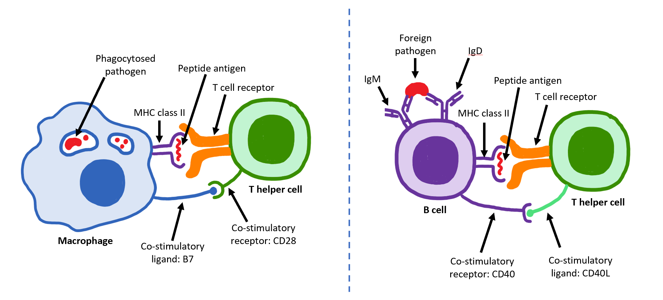
Mac interact with T cells in order to bring about T cell activation in target organs.
Mac activated by inflammatory cytokines produced by the T cells.

Slide 84
